Slide 1

Web Forms

Slide 2
Objectives
To be able to:
Understand how forms work
Use the <form> element
Create input objects
Style forms with Cascading Style Sheets (CSS)

Slide 3
HTML FORMS
Halaman HTML yang berfungsi untuk menyimpan dan mencatat data/informasi dari pengunjung (visitor)
Berisi berbagai macam input control seperti : textbox, listbox, button, etc.
HTML 5 Forms mencoba membenahi classic HTML Forms dengan membuatnya lebih mudah tanpa harus tergantung dengan elemen JavaScript

Slide 4
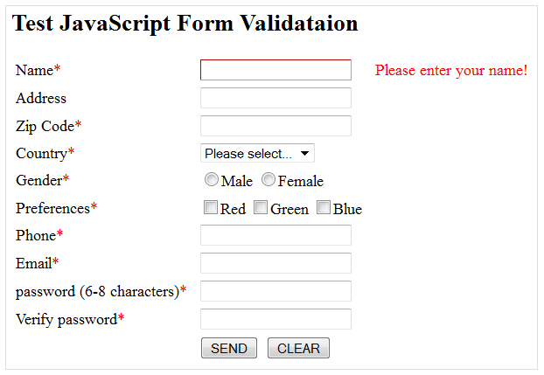
Campur Tangan JavaScript
Reference: http://www3.ntu.edu.sg/home/ehchua/programming/webprogramming/JavaScript_Examples.html

Slide 5
Campur Tangan Javascript
Pada umumnya digunakan untuk memvalidasi form
Contoh: validasi alamat email, tanggal lahir, nomer telepon, dst…
Apa yang terjadi jika fitur javascript pada browser dimatikan?
Reference: https://productforums.google.com/forum/#!topic/chrome/BYOQskiuGU0%5B1-25-true%5D

Slide 6
Memahami Web Forms
A web form is a collection of text boxes, lists, buttons, and other clickable widgets that a web surfer uses to supply some sort of information to a website.
Contoh : form registrasi user baru, form pembuatan email account, form contact pelanggan, form pengaduan layanan, form pemesanan barang, dsb

Slide 7
Proses Di Balik Web Forms
Melalui web form, pengunjung mengirimkan data kepada server
Server akan mengelola data tersebut dan menyimpannya di dalam database
Jika diperlukan server juga dapat mengambil data dari database sesuai dengan permintaan pengunjung dan mengirimkan kembali kepada browser/pengunjung
Apa yang terjadi jika data yang dikirimkan tidak valid? Proses pengecekan?
SERVER
WEB FORMS
DATABASE

Slide 8
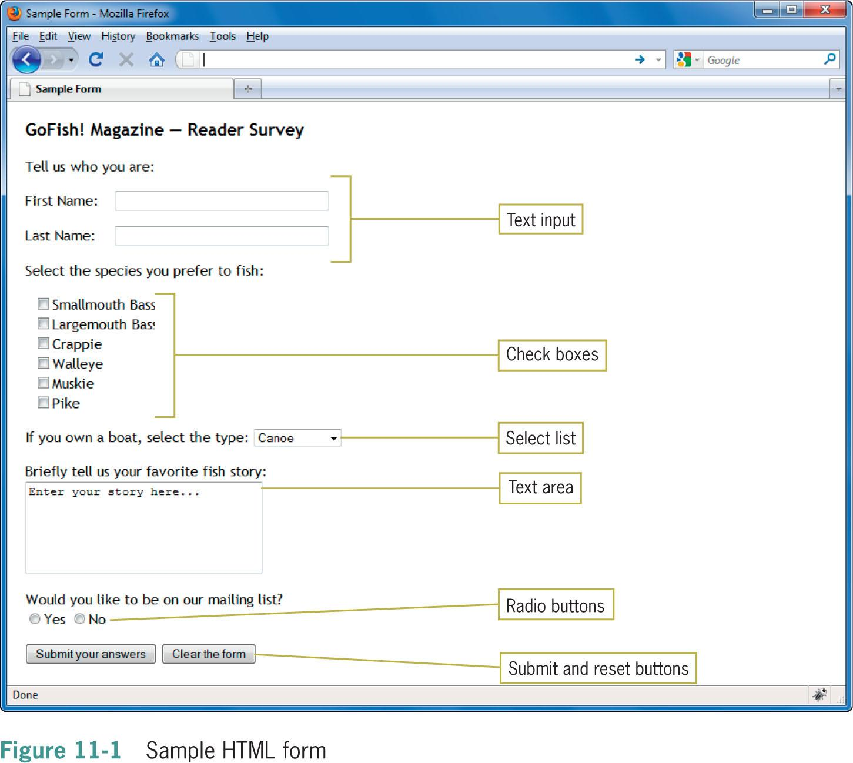

Slide 9
Using the <form> element
The <form> element is the container for creating a form
A variety of attributes describe how the form data will be processed

Slide 10
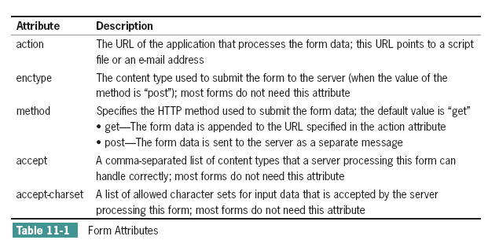
<form method="post" action="register.php">

Slide 11
Using get or post
The difference between get and post is the way the data is sent to the server
method=“get”: this method sends the form information by including it in the URL https://www.google.com/#hl=en&output=search&sclient=psy-ab&q=search+string&oq=search+string&aq=f&aqi=g4&aql=&gs_nf=1
method=“post”: this method sends the form information to the server within the message body

Slide 12
Creating Input Objects
The <input> element defines many of the form input object types
The type attribute specifies the type of input object

Slide 13
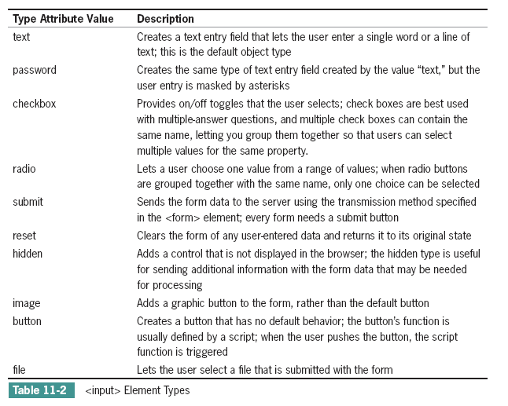

Slide 14
Labeling Form Elements
The <label> element lets you create a caption for an input element
Lets you extend the clickable area of a form element
<p>
<label class="username">First Name:</label>
<input type="text" name="firstname"
size="35" maxlength="35" />
</p>
What's wrong with this example?

Slide 15
Labeling Form Elements
To actually make the text clickable, you associate the <label> element with the <input> element by using the for and id attributes (or wrapping the input element in the label element)
<p>
<label class="username" for="First Name">
First Name:</label>
<input type="text" name="firstname" id="First Name"
size="35" maxlength="35" />
</p>

Slide 16
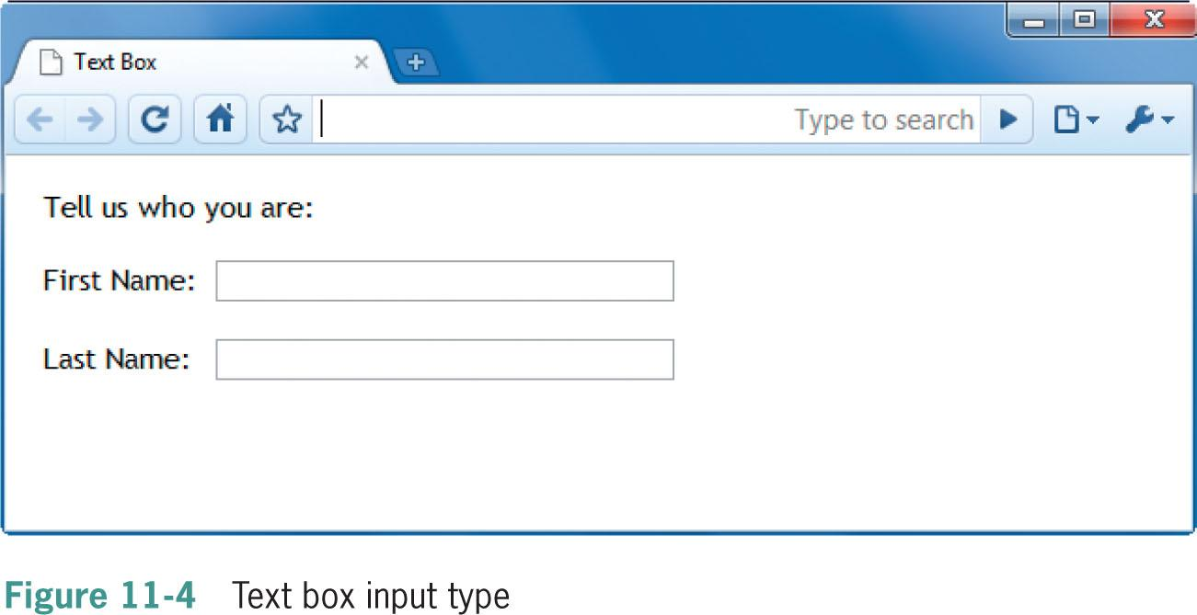
Creating Text Boxes
The text box is the most commonly used form element
<input type="text" name="firstname" size="20" maxlength="35" value="">

Slide 17
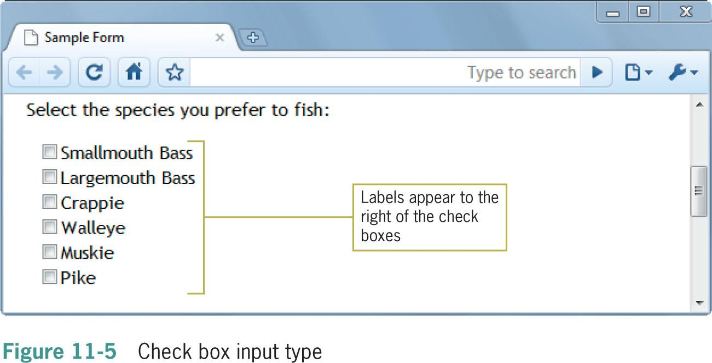
Creating Check Boxes
Check boxes are an on/off toggle that the user can select
<input type="checkbox" name="species" value="smbass"> <label> Smallmouth Bass </label>

Slide 18
Creating Radio Buttons
Radio buttons are like check boxes, but only one selection is allowed
<p>Would you like to be on our mailing list?</p>
<p>
<input type="radio" name="list" value="yes"
id="Yes" />
<label for="Yes">Yes</label>
<input type="radio" name="list" value="no" id="No" />
<label for="No">No</label>
</p>
Multiple buttons must have the same name

Slide 19
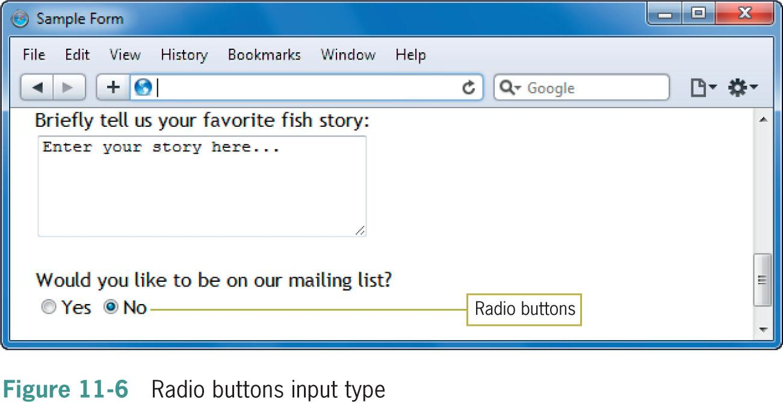

Slide 20
Checkbox and Radio List
Try to put “checked” keyword in a certain <input> tag
<input type=“checkbox” checked ……>

Slide 21
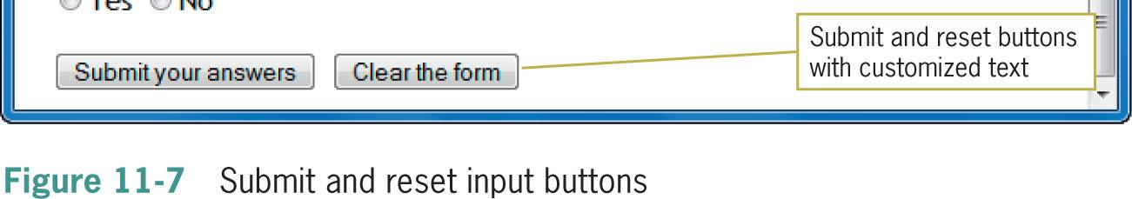
Creating Submit & Reset Buttons
The submit and reset buttons let the user choose whether to send the form data or start over
<input type="submit" value="Submit your answers">
<input type="reset" value="Clear the form">

Slide 22
Letting the User Submit a File
Users can select a file on their own computer and send it to the server
<p>Use the browse button to select your file:</p>
<p><input type="file" size="30“></p>

Slide 23
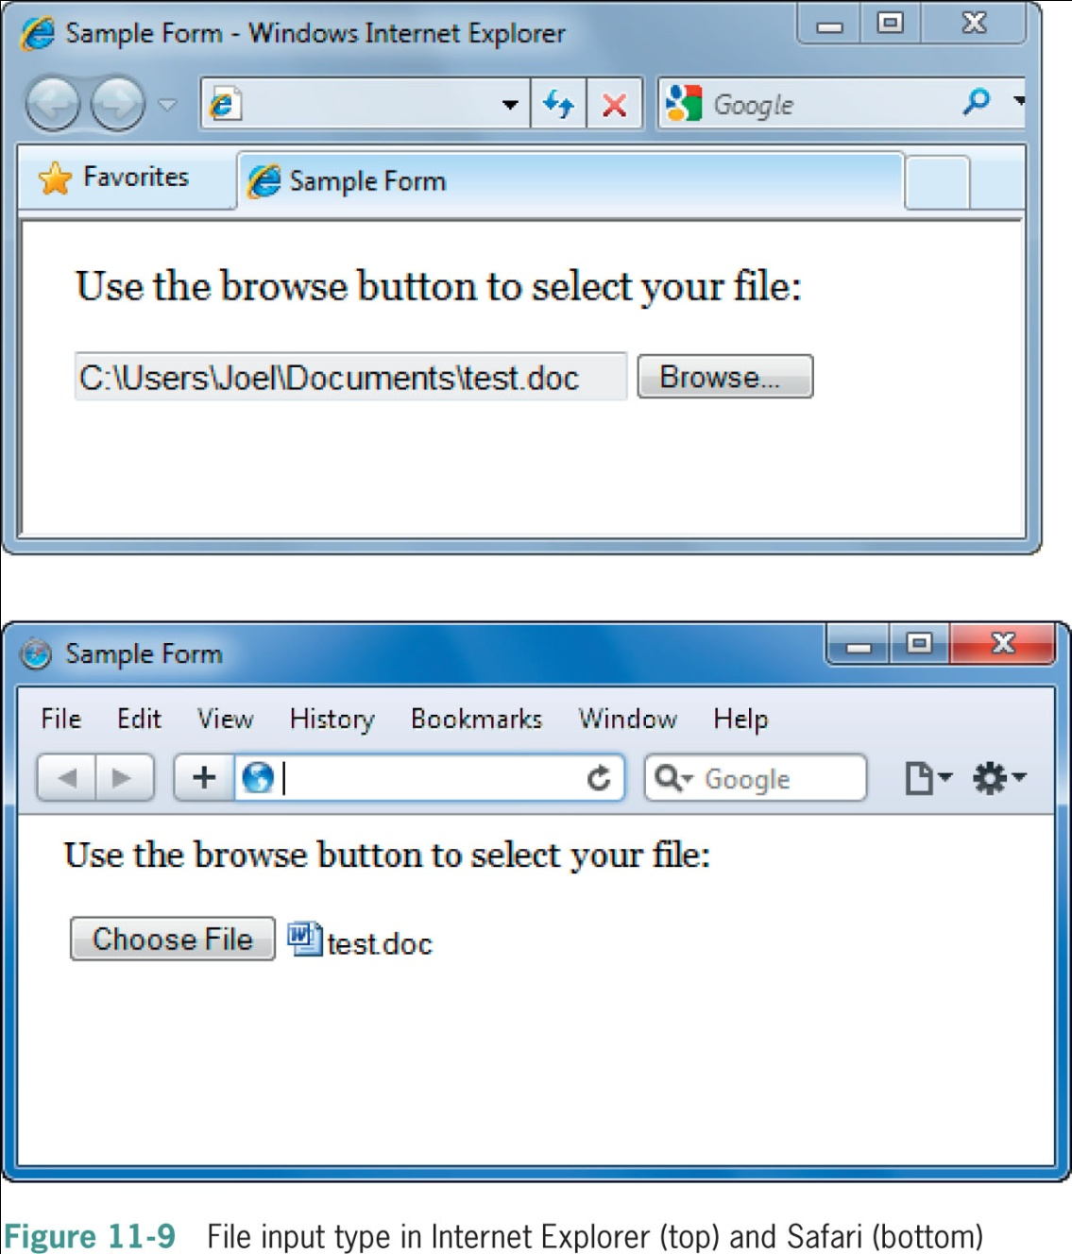

Slide 24
Creating a Password Entry Field
The password input box works like the text input, but the entered text is hidden by asterisks
<p>Enter your user name and password:</p>
<p>
User Name: <input type="text" size="30" />
Password: <input type="password" size="30" />
</p>

Slide 25
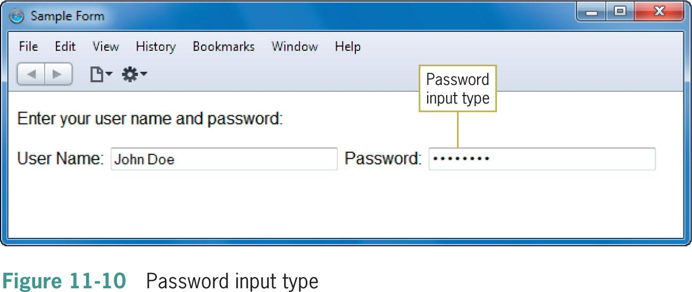

Slide 26
Using the <select> Element
The <select> element lets you create a list box or scrollable list of selectable options
<select name="boats">
<option value=“1”>Canoe</option>
<option value=“2”>Jon Boat</option>
<option value=“3”>Kayak</option>
<option value=“4”>Bass Boat</option>
<option value=“5”>Family Boat</option>
</select>

Slide 27
Using the <select> Element
The <select> element lets you create a list box or scrollable list of selectable options
<select name="boats">
<option value=“1”>Canoe</option>
<option value=“2”>Jon Boat</option>
<option value=“3”>Kayak</option>
<option value=“4” selected>Bass Boat</option>
<option value=“5”>Family Boat</option>
</select>
You may add “selected” keyword in certain option

Slide 28
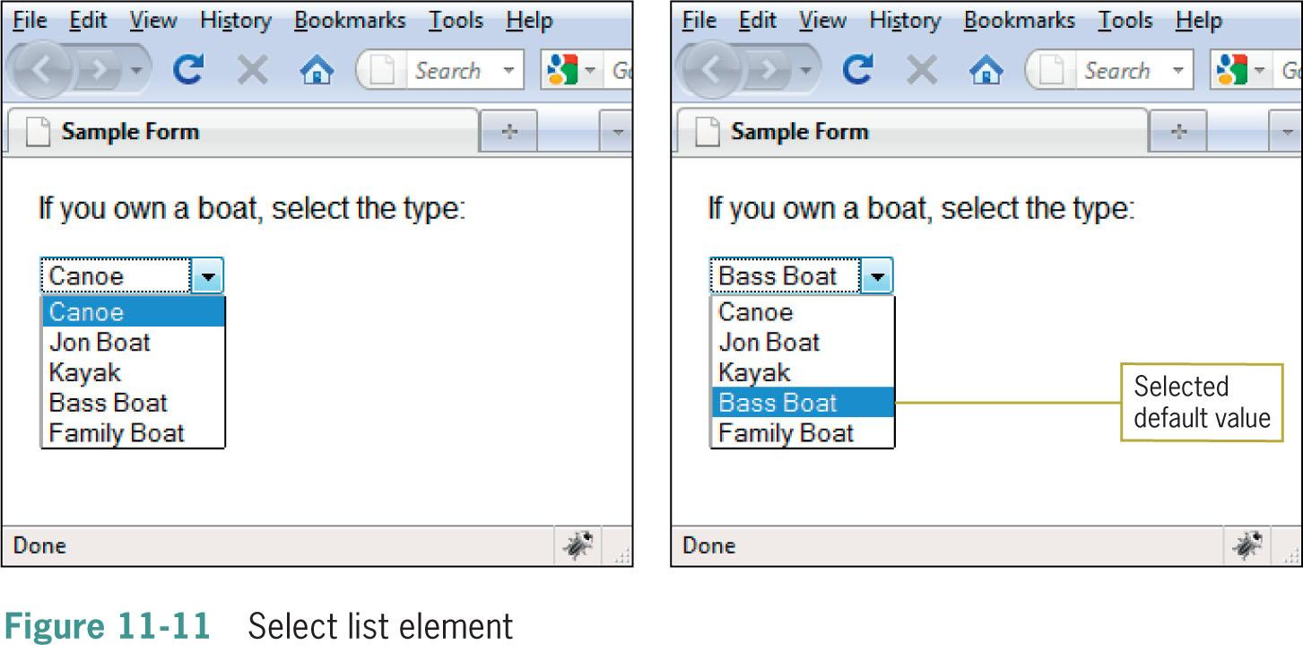

Slide 29
Using the <select> Element
You can choose to let the user pick multiple values from the list by adding the multiple attribute
<select name="snacks" multiple size="6">
<option value=“1”>Potato Chips</option>
<option value=“2”>Popcorn</option>
<option value=“3”>Peanuts</option>
<option value=“4”>Pretzels</option>
<option value=“5”>Nachos</option>
<option value=“6”>Pizza</option>
<option value=“7”>Fries</option>
</select>

Slide 30
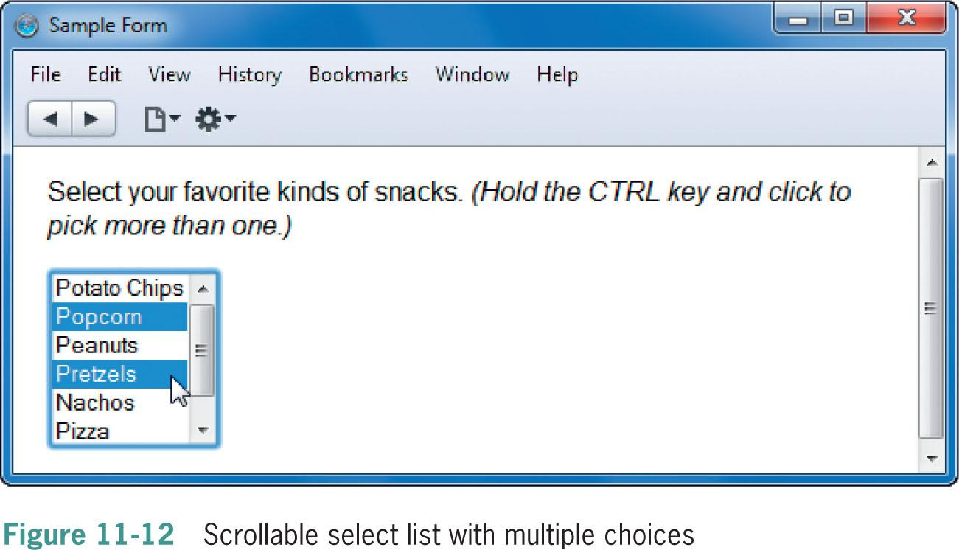

Slide 31
Using the <select> Element
You group and label sets of list options with the <optgroup> element and label attribute
<select name="snacks" multiple size="6">
<optgroup label="Salty Snacks">
<option value=“1”>Potato Chips</option>
<option value=“2”>Popcorn</option>
</optgroup>
<option value=“3”>Peanuts</option>
<option value=“4”>Pretzels</option>
<option value=“5”>Nachos</option>
<option value=“6”>Pizza</option>
<option value=“7”>Fries</option>
</select>

Slide 32
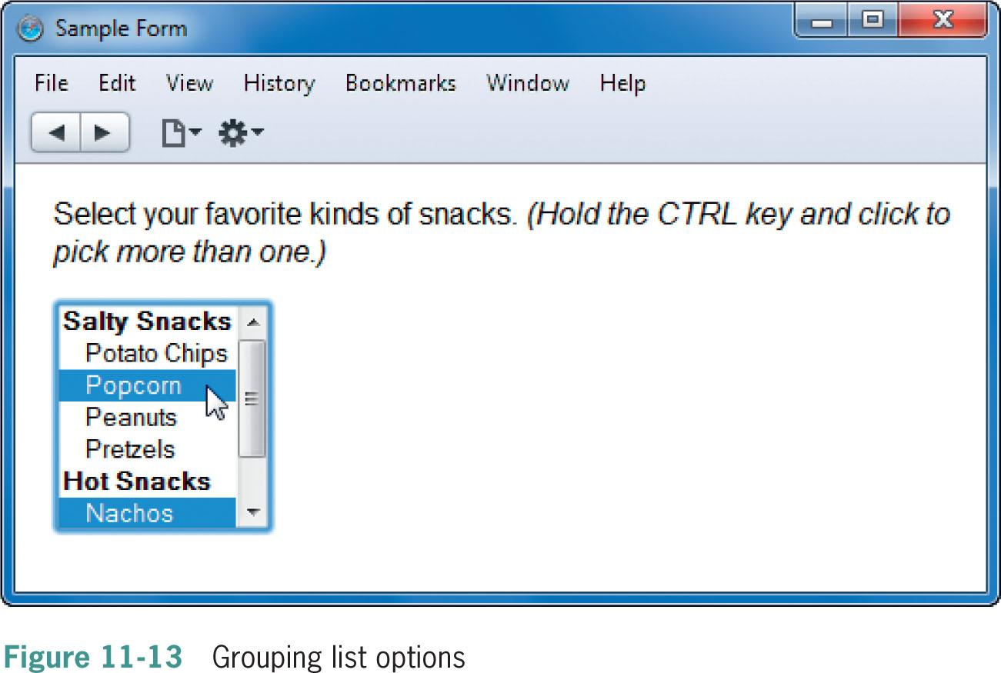

Slide 33
Using the <textarea> Element
The <textarea> element lets you create a larger text area for user input
<p><b>Briefly tell us your favorite fish story:</b><br>
<textarea name="fishstory" rows="5" cols="30">
Enter your story here...
</textarea>
</p>

Slide 34
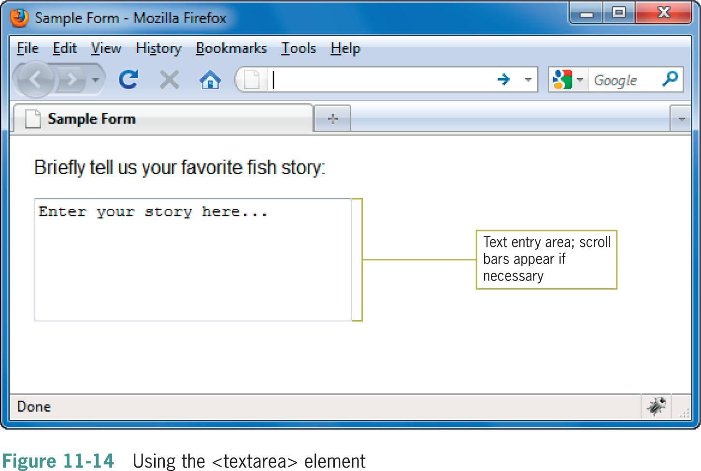

Slide 35
Hidden element
You are going to need hidden element when you want to store a value in a form, but it is hidden from user
<input type=“hidden” name=“hid_my_nrp” value=“160416001”>

Slide 36
Creating Input Groupings
You can use the <fieldset> and <legend> elements to create groupings of different types of input elements

Slide 37
Creating Input Groupings
<fieldset>
<legend><b>Select the species you prefer to fish:</b></legend>
<input type="checkbox" name="species" value="smbass"> Smallmouth Bass
<input type="checkbox" name="species" value="lgbass"> Largemouth Bass <br>
<input type="checkbox" name="species" value="pike"> Pike
</fieldset>

Slide 38
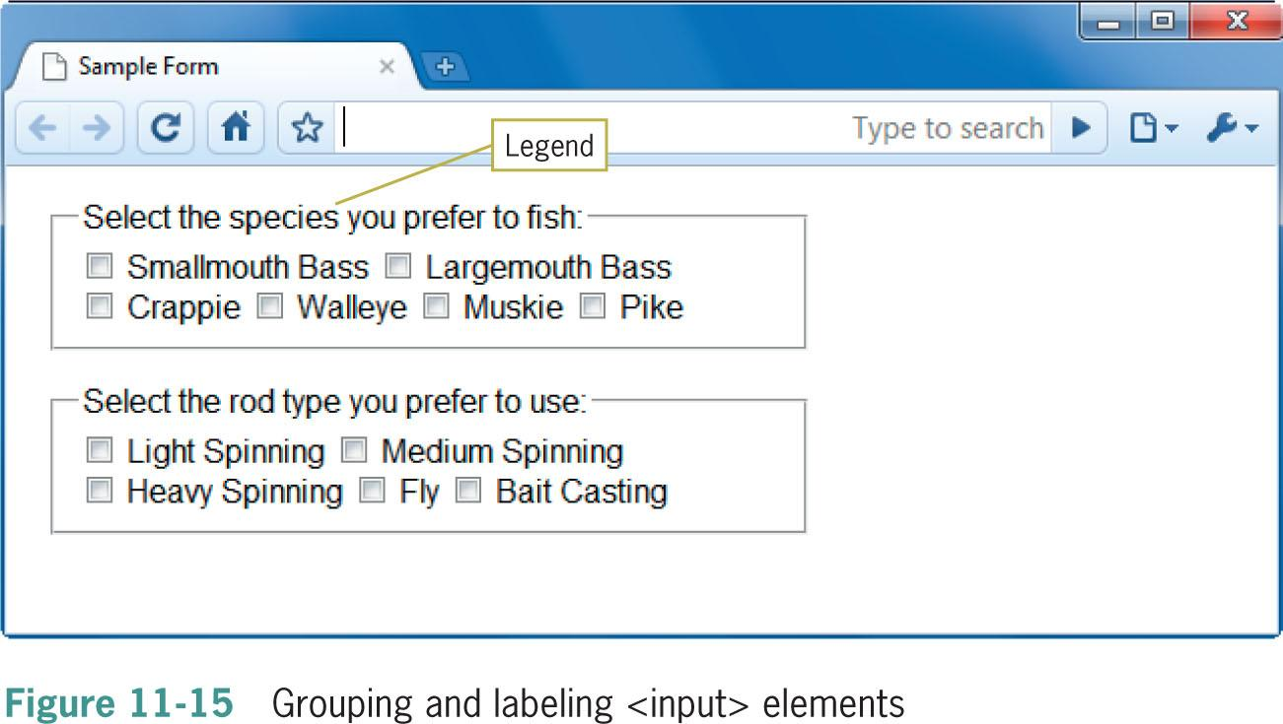

Slide 39
Styling Forms with CSS
You can use many of the CSS properties to specify type styles, background colors, box properties, and colors to enhance the look of your forms
The grouping and labeling elements <fieldset>, <legend>, and <label> are useful when applying styles to forms

Slide 40
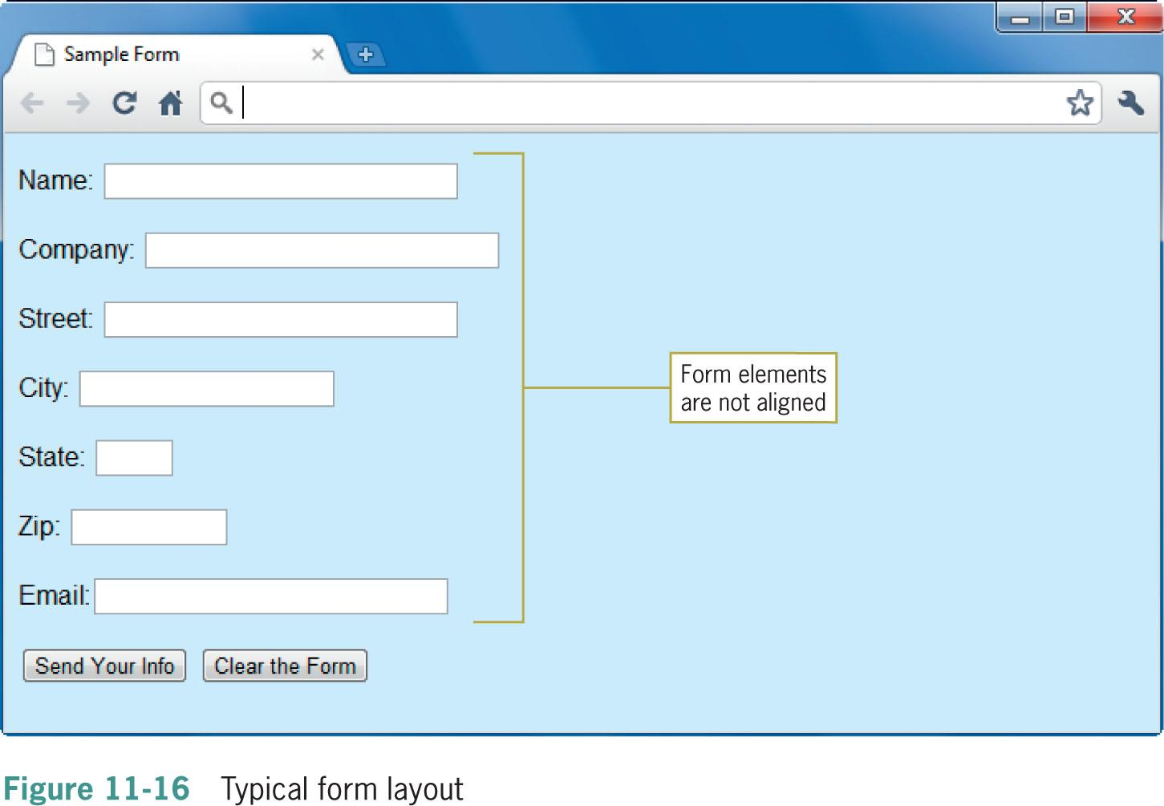

Slide 41
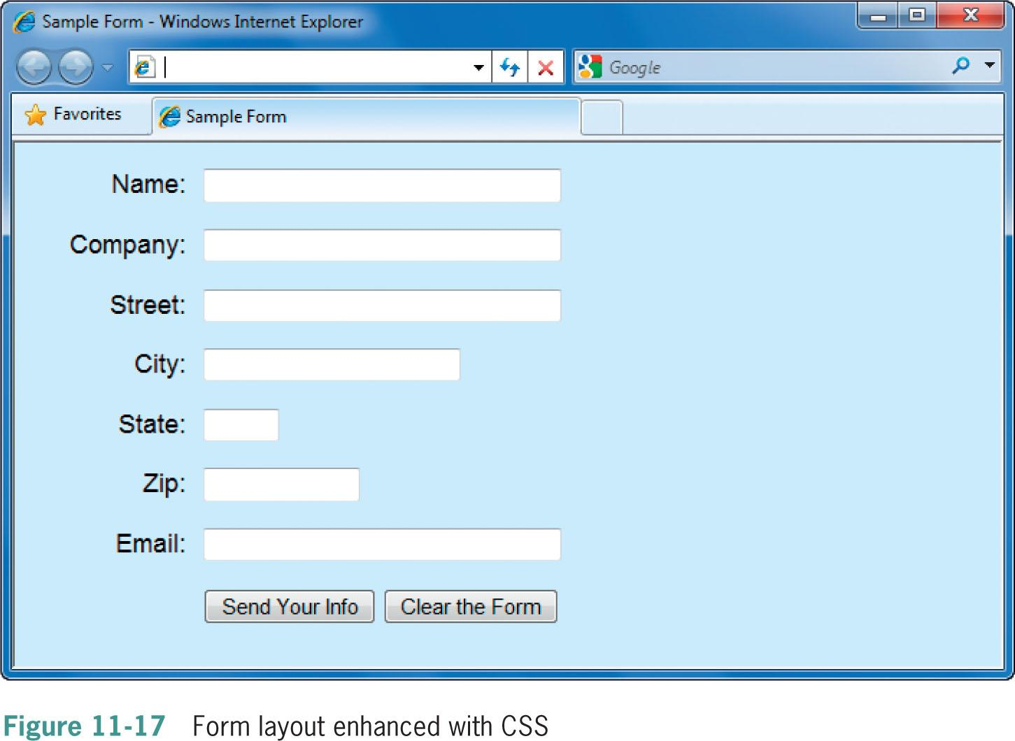
label { float: left; width: 6em; text-align: right; margin-right: 10px; }

Slide 42
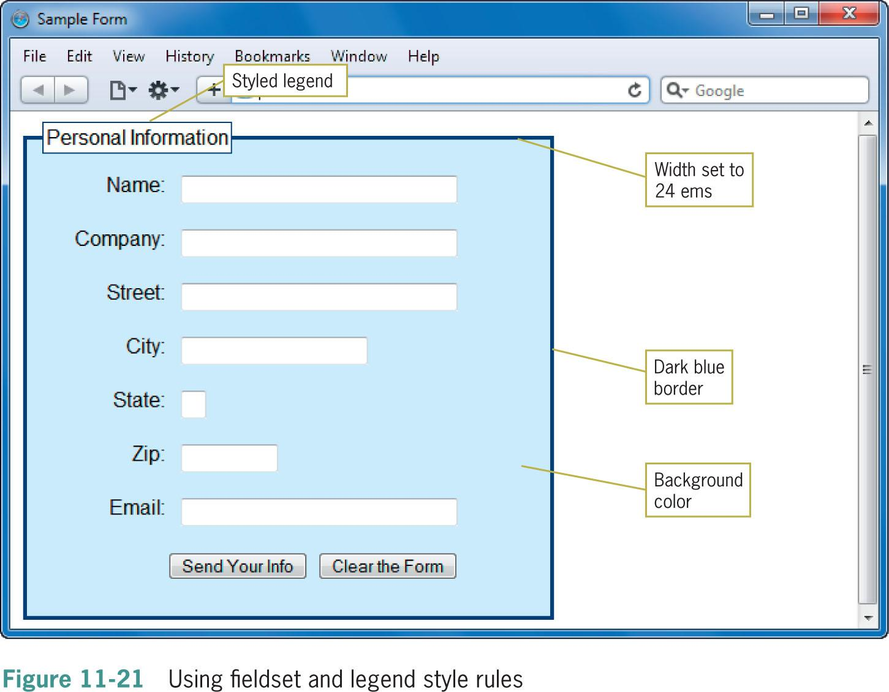

Slide 43
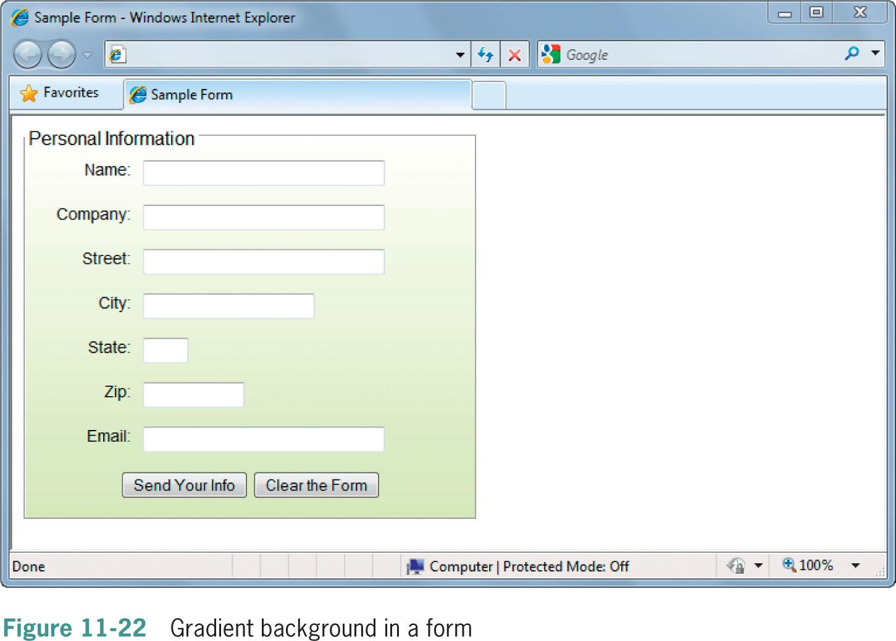

Slide 44
Make User Friendly Forms
Use labels for all fields, especially check boxes and radio buttons
Use a proper submit button
Think about tab order – make it natural
Use conventional names so users have their previous data available (e.g. name=“email” not name=“emailfield”
Aim for fewest clicks (e.g. radio buttons vs. lists)
Don’t be too ‘strict’ with form validation
Consider your (global) audience

Slide 45
NEW HTML 5 FORM FEATURE

Slide 46
HTML 5 Form Feature
Placeholder
Autofocus
Validation
Validation with Regular Expression

Slide 47
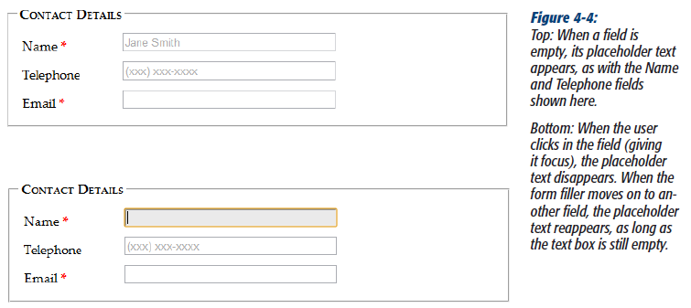
Placeholder
Placeholder digunakan untuk memberikan contoh cara pengisian sebuah elemen form kepada user

Slide 48
Latihan
<label for="name">Name <em>*</em></label>
<input id="name" placeholder="Jane Smith"><br>
<label for="telephone">Telephone</label>
<input id="telephone" placeholder="(xxx) xxx-xxxx"><br>
Untuk mengganti tampilan dari placeholder ini dapat dilakukan melalui css (pseudoclass)
input:focus {
background: #eaeaea;
}

Slide 49
AUTOFOCUS JAVASCRIPT
Ketika semua halaman selesai diload, fokus kursor user akan diarahkan pada elemen form yang pertama kali. Sehingga user dapat langsung mengisikan form tersebut.
Hal ini bisa dilakukan dengan bantuan JavaScript (pemanggilan fungsi focus() pada elemen form)
Namun permasalahan muncul apabila form belum 100% load, dan user mengklik manual pada sebuah elemen form. Ketika form telah sepenuhnya selesai diload, kursor user akan dipaksa dipindahkan ke elemen form yang pertama kali.

Slide 50
AUTOFOCUS HTML 5
HTML5’s new autofocus attribute, yang dapat ditambahkan pada single <input> atau <textarea> element:
<label for="name">Name <em>*</em></label>
<input id="name" placeholder="Jane Smith" autofocus><br>
Kelebihan autofocus HTML 5 adalah tidak mengandalkan javascript

Slide 51
VALIDATION
A way to catch mistakes when they happen (or even better, to prevent them from happening at all).
Beberapa tahun terakhir developer menggunakan JavaScript libraries untuk melakukan validasi form.
HTML 5 memperkenalkan client-side validation system yang bertujuan untuk memasang error checking rules pada <input> field

Slide 52
DUA VALIDASI
Client-side validation. These are the checks that happen in the browser, before a form is submitted.
Server-side validation. These are the checks that happen after a form is sent back to the web server. (Diajarkan pada mata kuliah pemrograman web/pengembangan web)

Slide 53
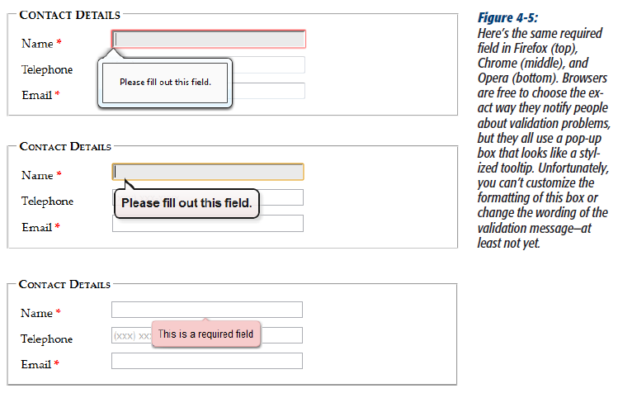
HTML 5 VALIDATION

Slide 54
HTML 5 VALIDATION
Contoh: memasang validasi pada input elemen yang harus diisi (tidak boleh kosong/blank)
<label for="name">Name <em>*</em></label>
<input id="name" placeholder="Jane Smith" autofocus required><br>
HTML 5 Validation adalah salah satu bentuk pengecekan dari sisi client (client-side validation)
Untuk uji coba silahkan kosongi input “name” dan tekan submit button.

Slide 55
PSEUDOCLASS CSS
Untuk mengganti tampilan pada saat form memvalidasi isian user, gunakan pseudoclass berikut :
required and optional, which apply styles to fields based on whether they use the required attribute.
valid and invalid, which apply styles to controls based on whether they contain mistakes.
in-range and out-of-range, which apply formatting to controls that use the min and max attributes to limit numbers to a range

Slide 56
CONTOH PSEUDOCLASS
Untuk memberikan background warna kuning muda pada elemen input yang wajib diisi (required) :
input:required {
background-color: lightyellow;
}
Atau anda dapat menandai field mana saja yang wajib diisi dan masih mengandung invalid values :
input:required:invalid {
background-color: lightyellow;
}

Slide 57
MEMATIKAN VALIDATION
Dengan cara menambahkan atribute nonvalidate pada tag <form>
<form id="zooKeeperForm" action="processApplication.php" novalidate>
Dengan cara menambahkan atribute formnonvalidate pada button yang digunakan untuk mensubmisi form
<input type="submit" value="Save for Later" formnovalidate>

Slide 58
VALIDATION DENGAN REGULAR EXPRESSION
Salah satu jenis validasi terkompleks dan terkuat. Menggunakan JavaScript dan sekarang diadopsi oleh HTML 5
Regular Expression adalah pola terformat yang dibuat dengan bahasa regular expression.
Regular Expression bertujuan untuk mencocokan antara input dengan pola teks yang dibuat.
Referensi :
http://www.regular-expressions.info/reference.html
http://regexlib.com
http://html5pattern.com/

Slide 59
Contoh : [A-Z]{3}-[0-9]{3}
A-Z diawal menunjukkan bahwa inputan harus diawali dengan huruf kapital antara range A sampai Z
Kurung berisi angka 3 berikutnya menunjukkan bahwa inputan harus diawali dengan 3 huruf kapital (antara A-Z)
Tanda minus (-) tidak memiliki arti apa-apa selain tanda itu harus ada selanjutnya setelah menuliskan tiga huruf kapital
0-9 menunjukkan bahwa inputan selanjutnya harus mengandung angka antara 0-9
Sedangkan kurung angka 3 menunjukkan bahwa selanjutnya harus berisi 3 digit angka

Slide 60
Contoh : [A-Z]{3}-[0-9]{3}
Value di bawah ini valid karena sesuai dengan pola :
QRB-001
TTT-952
LAA-000
Value di bawah ini tidak valid karena tidak sesuai pola :
qrb-001
TTT-0952
LA5-000

Slide 61
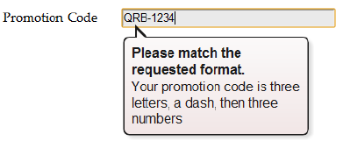
MEMASANG REGULAR EXPRESSION PADA ELEMENT FORM
Regular Expression dapat dipasang pada elemen textarea atau input untuk memvalidasi inputan user
Contoh :
<label for="promoCode">Promotion Code</label>
<input id="promoCode" placeholder="QRB-001" title=
"Your promotion code is three uppercase letters, a dash, then three numbers” pattern="[A-Z]{3}-[0-9]{3}">

Slide 62
JENIS INPUT TYPE BARU

Slide 63
JENIS INPUT TYPE BARU
Tag <Input> memiliki beberapa type baru antara lain : (Catatan: browser support atau tidak. Sehingga tidak semua input type baru ini dapat dijalankan di semua browser)
Email Addresses
URLs
Search Boxes
Telephone Numbers
Numbers
Sliders
Dates & Times
Colors

Slide 64
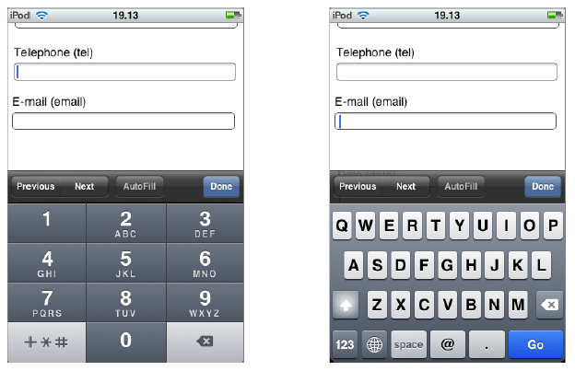
Email Addresses
<label for="email">Email <em>*</em></label>
<input id="email" type="email">

Slide 65
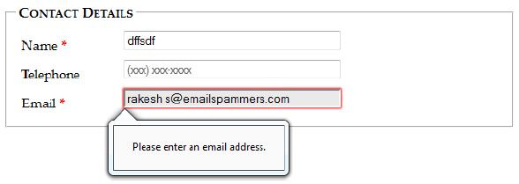
Email Addresses
Type ini berfungsi untuk membuat browser melakukan validasi otomatis pada inputan email
Validasi email sangat kompleks jika menggunakan regular expression

Slide 66
NUMBERS
min = membatasi rentang minimum nilai yang boleh diinput
max = membatasi rentang maximum nilai yang boleh diinput
step = membatasi fraksi angka yang boleh diinputkan
Contoh :
<label for="weight">Weight (in pounds)</label>
<input id="weight" type="number" min="50" max="1000" value="160"><br>
Contoh 2:
<label for="weight">Weight (in pounds)</label>
<input id="weight" type="number" min="50" max="1000" step="0.1" value="160"><br>
Contoh 3:
<label for="weight">Weight (in pounds)</label>
<input id="weight" type="number" min="50" max="1000" step=“any" value="160"><br>

Slide 67

SLIDER
Sebuah control baru HTML yang menampilkan bar slider dengan batas minimum dan maksimum
<label for="weight">Weight (in pounds)</label>
<input id="weight" type="range" min="50" max="1000" value="160"><br>

Slide 68
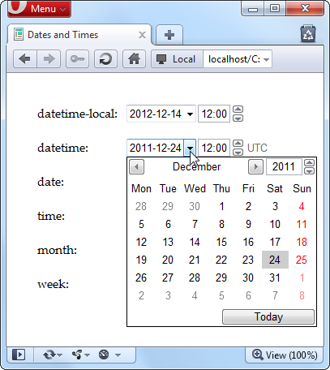
DATES AnD TIMES
Tidak semua browser support!
<input type=”date” min=”2012-01-01”
max=”2012-12-31”>
Catatan:
TIDAK semua browser mendukung tipe data date.
Oleh karena keterbatasan dukungan browser pada tipe “date” ini, maka sebaiknya Anda gunakan saja komponen javascript yang tersedia gratis untuk membuat input tanggal/waktu

Slide 69
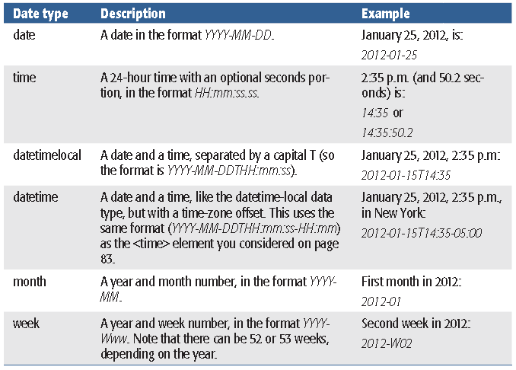
DATE AND TIMES

Slide 70
ELEMEN BARU
<datalist>
<progress>

Slide 71
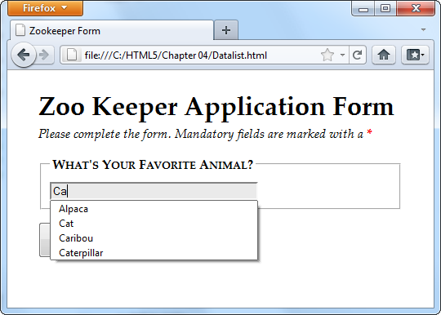
<Datalist>
<legend>What's Your Favorite Animal?</legend>
<input id="favoriteAnimal">
Kemudian letakkan <datalist>. Boleh dimana saja.
<datalist id="animalChoices">
<option label="Alpaca" value="alpaca">
<option label="Zebra" value="zebra">
<option label="Cat" value="cat">
<option label="Caribou" value="caribou">
<option label="Caterpillar" value="caterpillar">
<option label="Anaconda" value="anaconda">
<option label="Human" value="human">
<option label="Elephant" value="elephant">
<option label="Wildebeest" value="wildebeest">
<option label="Pigeon" value="pigeon">
<option label="Crab" value="crab">
</datalist>

Slide 72
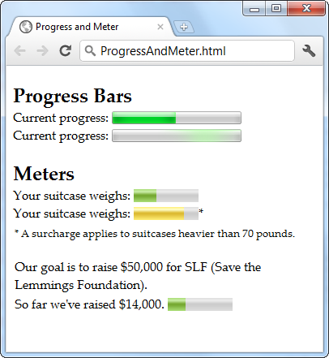
<PROGRESS>
<progress value="50" max="200"></progress>
Jika browser tidak support isikan nilainya <progress value="0.25">25%</progress>

Slide 73
Summary
Choose the right form elements based on the data you want to collect
A form element has attributes that describe how the form data is processed
You need a server application to process your form data
The <fieldset> and <legend> elements let you create more visually appealing forms
Forms should be formatted to improve their legibility

Slide 74
Home Work 1
Try to design your own LOGIN page

Slide 75
Home Work 2
Try to design your own Skripsi Submission Page
You have to provide the title of your topic, the desired supervisors, and you need to upload the proposal

